Slide 1


Propensity To Convert Models - Predicting the the likelihood of Customer accepting Personal Loan Offer
Supraja Rapuru

Slide 2
Agenda
Introduction
Personal Loan Data
Predictive Modeling
Risks / Contingencies
Exploratory Data Analysis
Data Preparation
Overall Model Performance
Conclusion

Slide 3
Introduction
Banks spend millions of dollars on marketing teams and the campaigns in targeting right customer, right channel where the response rate is higher when offer is made. Based on various studies made and the observation I have at my work, the response rate is very low, response rate is below 5% in personal loans space.
The low acceptance rate means that randomly choosing customers to market to is incredibly wasteful in terms of both time and money. Thus, it is in the interest of the banks to determine which customers are the most likely to accept this type of loan based on the customer's information. Also the creatives that are being sent are looked at being more personalized so that message in the offer resonates with their situation and make the customers to accept the rate.

Slide 4
Personal Loan Data
Simulated dataset from Kaggle titled "Personal Loan Modeling" . It contains a list of bank customer's data resulting from a marketing campaign.
The data include customer demographic information (age, income, etc.), the customer's relationship with the bank (mortgage, securities account, etc.), and the customer response to the last personal loan campaign (Personal Loan). Among these 5000 customers, only 480 (= 9.6%) accepted the personal loan that was offered to them in the earlier campaign.
14 features
all are numerical

Slide 5
Predictive Modeling
Classification problem
Logistic Regression
Random Forest
K-nearest Neighbors
Grid Search with cross validation
Test multiple different models with multiple different hyperparameters
Cross validates and selects the best model / hyperparameter combo for the dataset

Slide 6
Risks / Contingencies
The dataset is small and simulated dataset, it is highly possible that few models may perform poorly on the data hence as a contingency plan, I have aimed to apply multiple models and compare the results but still results may not be aligned with real world scenario but I take this opportunity in validating my understanding with end to end flow of applying predictive analytics to a problem.
In general such datasets would be imbalanced so I am keeping closed tab on sampling (under/over) and also hyper parameter tuning because it could help the algorithms distinguish the majority class from the minority data group in our dataset

Slide 7
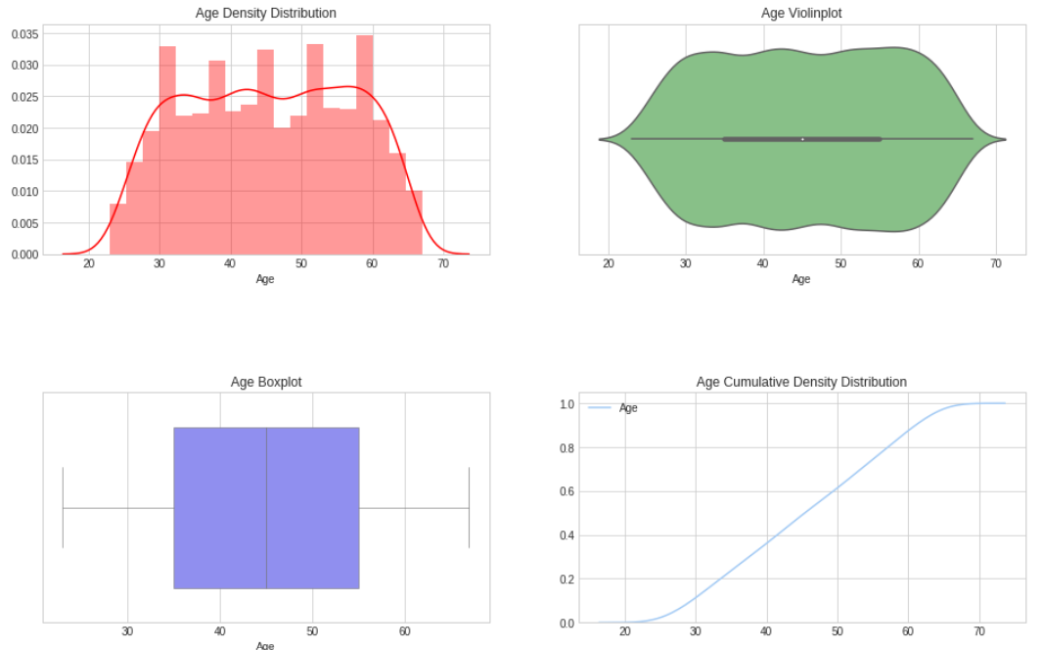
Exploratory Data Analysis
The age of the customers are uniformly distributed between the Min age of 23 and Max age of 67

Slide 8
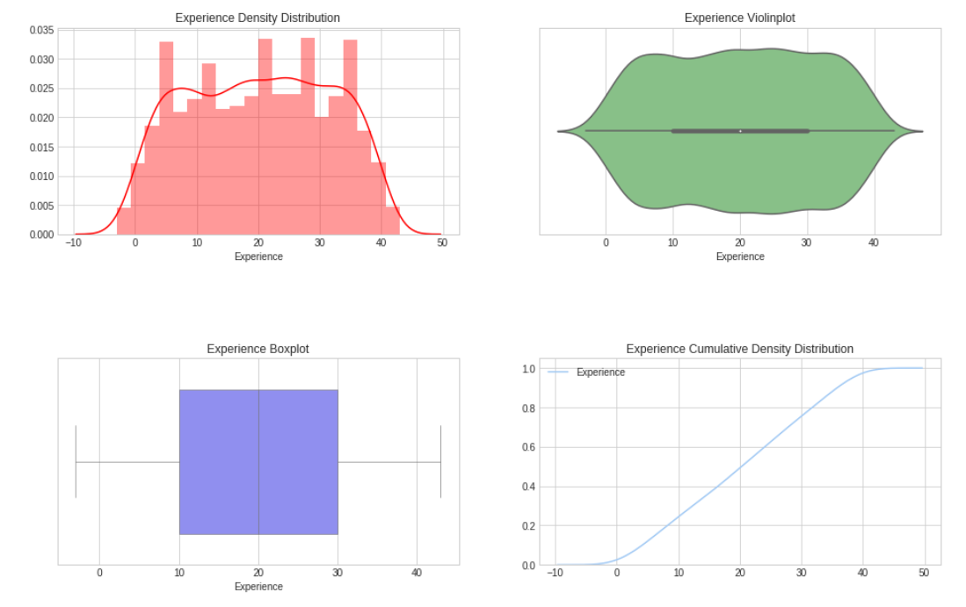
Exploratory Data Analysis
The work experience of the customers are uniformly distributed between the Minimum of -3 and Maximum of 43.

Slide 9
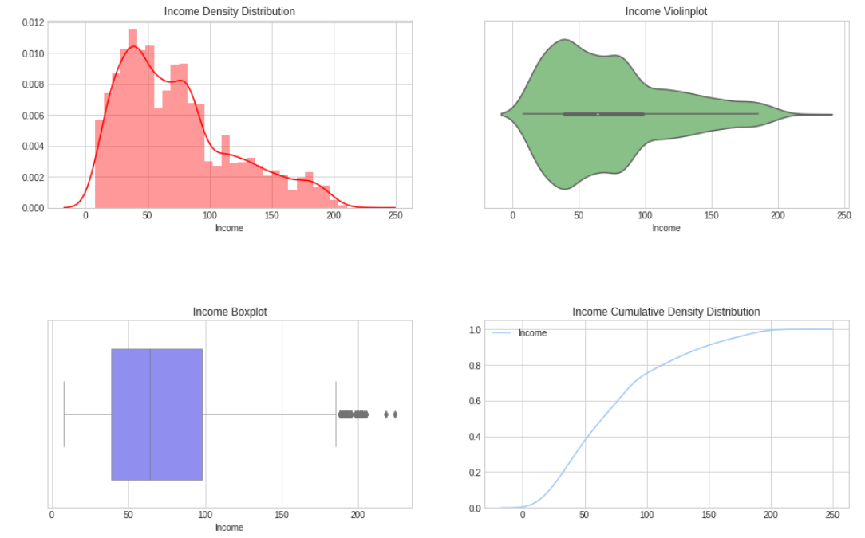
Exploratory Data Analysis
The income of the customers are skewed to the left with a median income of $64,000.
The Income attribute also has a lot of outlier values.

Slide 10
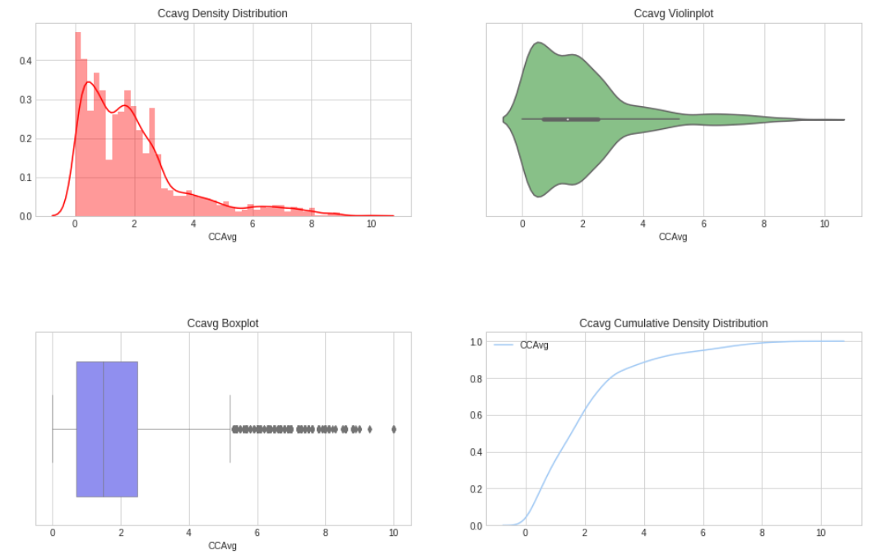
Exploratory Data Analysis
The Average Monthly Credit Card spending of the customers are skewed heavily to the left, with a lot of outlier values.

Slide 11
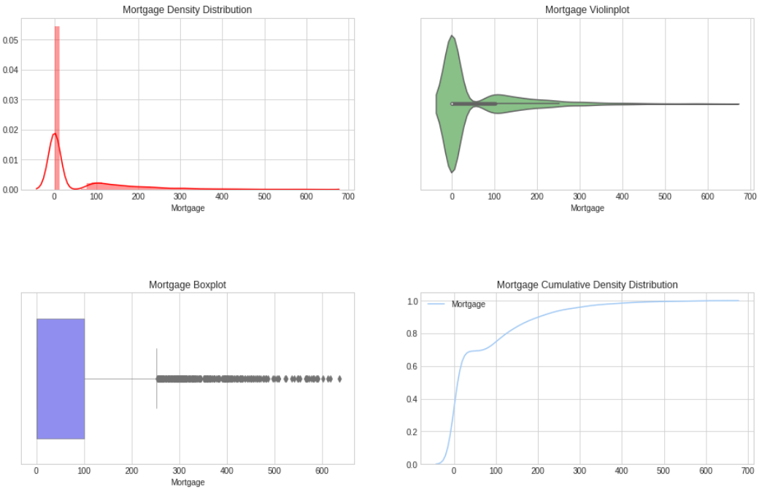
Exploratory Data Analysis
The Mortgage amount of the customers are skewed heavily to the left, with a lot of outlier values.
The nature of distribution of numerical columns suggest that we may need to standardize the data before training our models.

Slide 12
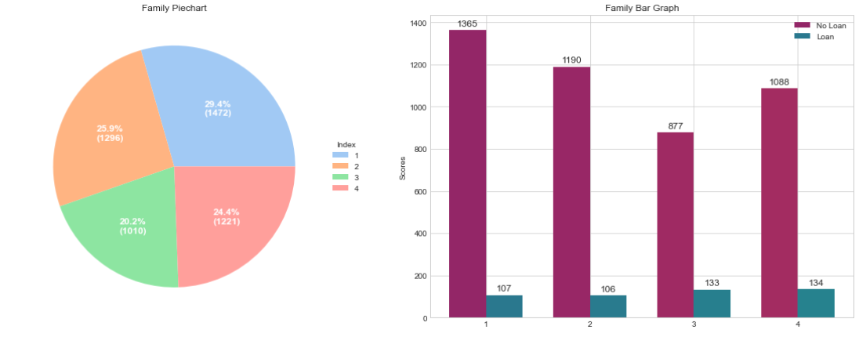
Exploratory Data Analysis
It is visible from the pie chart that the number of families with a size of 1 (29.44%) are more followed by families with size of 2 (25.92%).
Grouping it by personal_loan shows that the number of personal loans taken by a family of 4 is the highest. There is an interesting pattern that shows larger families feel a need to get personal loans more.

Slide 13
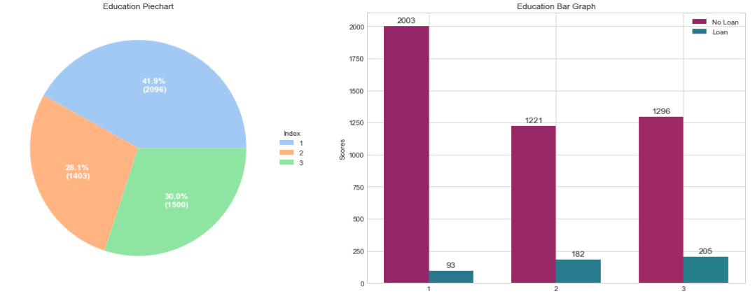
Exploratory Data Analysis
Most of the customers are undergraduates. There are more number of customers who have taken a personal_loan and Education level of Advanced followed by Graduates and Undergrads being the lowest which suggests that higher the education level the more the customer is confident and open to opt for personal_loan.

Slide 14
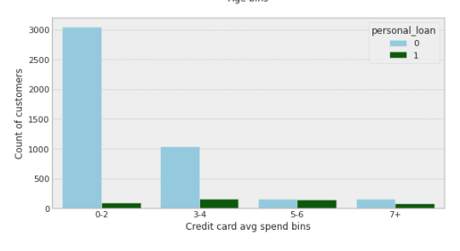
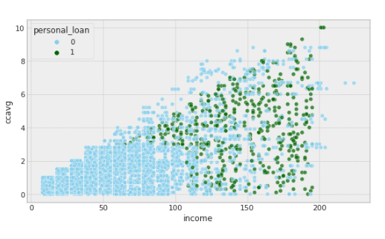
Exploratory Data Analysis
More than 50% of the customers have an average credit card spend in the range of 0-2 but has a very less number of people with personal_loan as compared to other bins. The customers with average credit card spend of 3-4 and 5-6 have a lot of customers who have taken a personal loan

Slide 15
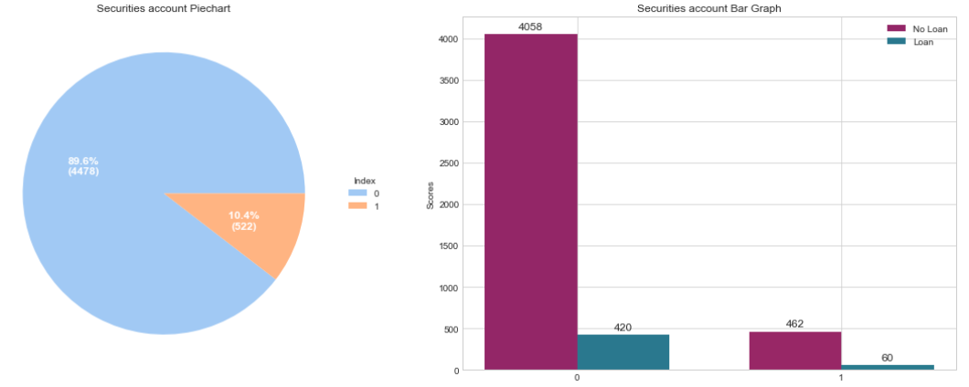
Exploratory Data Analysis
Majority of people do not have a securities account with the bank.
It is interesting to note that the percentage of people who have taken a personal loan and have a securities account is more than the percentage of people who have taken a personal loan but don't have a securities account.

Slide 16
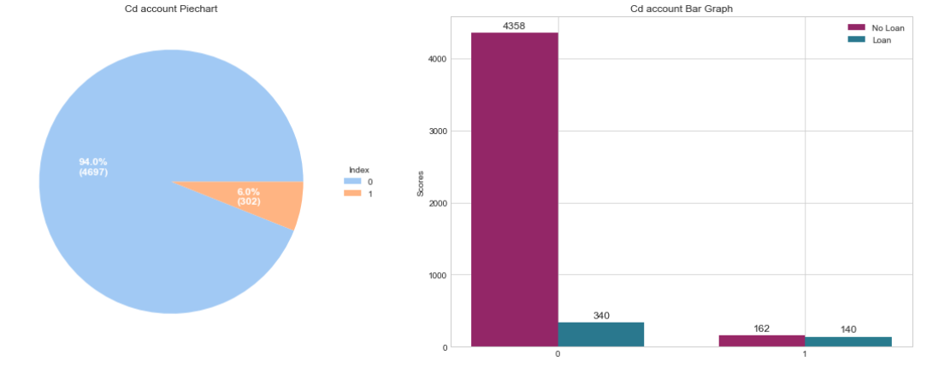
Exploratory Data Analysis
There a more number of customers who have a cd_account at the bank and have taken a personal_loan previously. Regardless of whether they have a cd_account or not, majority of them have an income of more than 100.

Slide 17
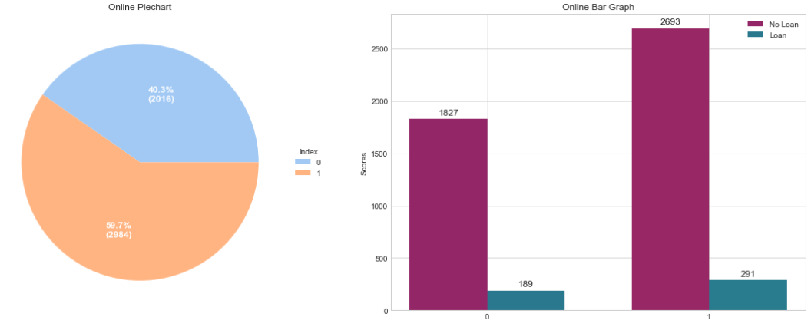
Exploratory Data Analysis
It is interesting to note that there many people who use online modes of transactions than people who still go the traditional way and amongst these people, the ones who use online modes of transaction, are more interested in opting for personal_loans maybe because spending money online is easy and tempting.

Slide 18
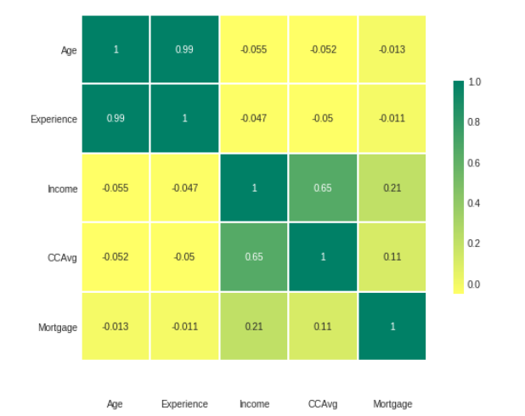
Exploratory Data Analysis
There is a very strong positive correlation between Age and Work Experience, which is expected.
There is also a positive correlation between Income and Credit Card spending.

Slide 19
Data Preparation
No missing values
Drop ID for modeling

Slide 20
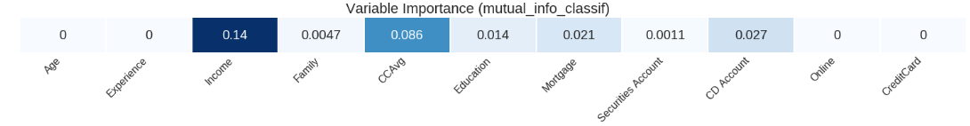
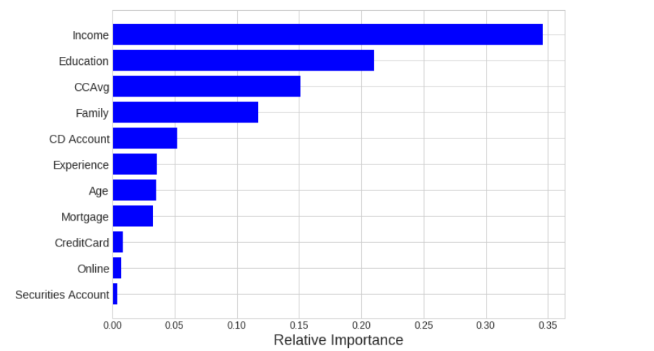
Feature Selection

Slide 21
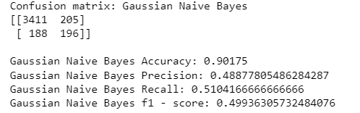
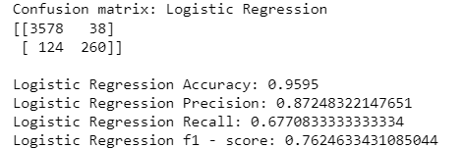
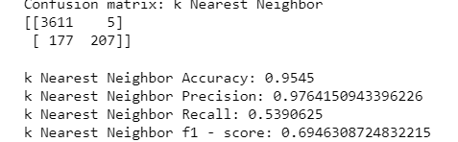
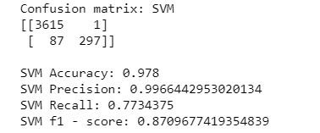
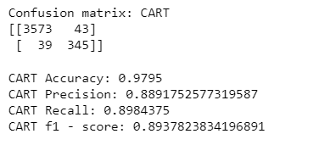
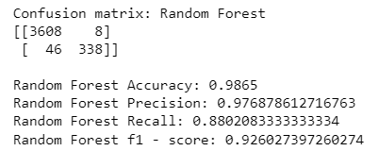
Base Models
All data was included, no class balancing
Pipeline included 6 different models (random forest, logistic regression, Gaussian Naïve Bayes, linear support vector, Decision Trees, and K-nearest neighbors)
Random Forest had the highest accuracy (98% in training)

Slide 22
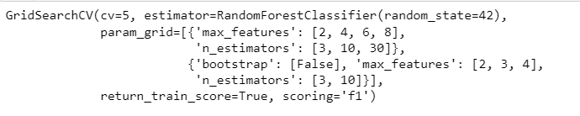
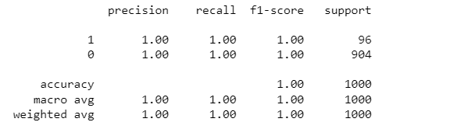
Tuning & Overall Model Performance
Used GridSearch for Hyperparameter tuning of our tree model. Grid search is a tuning technique that attempts to compute the optimum values of hyperparameters.
It is an exhaustive search that is performed on a the specific parameter values of a model. The parameters of the estimator/model used to apply these methods are optimized by cross-validated grid-search over a parameter grid.

Slide 23
Conclusion
Overall accuracy averaged between 90% and ~100%
Few key insights to highlight, Income ,Educatoin,Family,CCavg are most important factor.
Customers who have income above 98k dollars , Advance/graduate level education, a family of more than 2, such customers have higher chances of taking personal loans.
High Profile Clients :-Higher income,Advanced/Graduate level education, 3 /4 Family members,high spending
Average Profile :- Medium income group,Graduate level education.3/4Family members,medium spending
Low Profile:-Lower income group,undergrads ,3/4Family Member,low spending

